Slide 1

















Noida Institute of Engineering and Technology, Greater Noida
Anamika Srivastava
Assistant Professor CSE Department
CSE 8TH SEM
Mini Jain
AOE 0866 ST
Unit 4
1
JAN 1, 2023

Slide 2

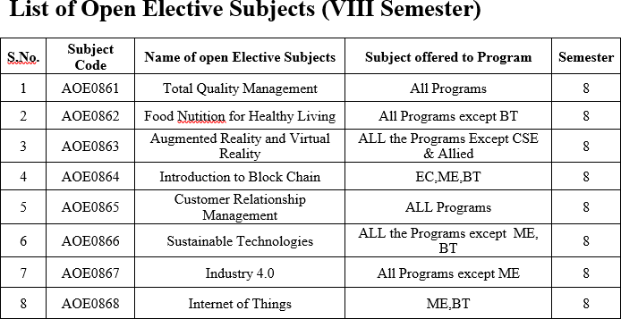
JAN 1, 2023
Mini Jain
AOE 0866 ST
Unit 4
2

Slide 3
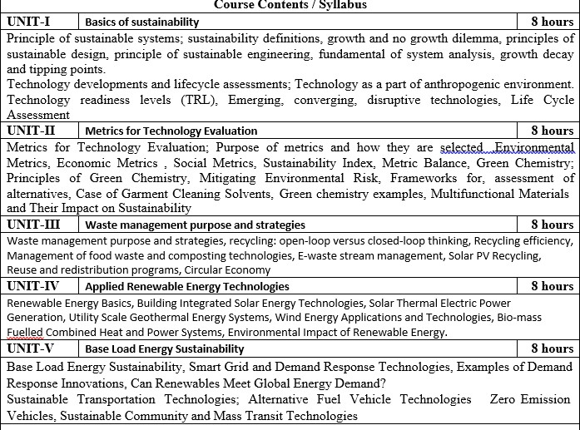
JAN 1, 2023
Mini Jain
AOE 0866 ST
Unit 4
3

Slide 4





Program Educational Objectives(PEOs)
To have an excellent scientif ic and engineering breadth so as
to
comprehend, analyze, design and provide sustainable solutions for
real-life problems using state-of-the-art technologies.
To have a successful career in industries, to pursue higher studies or
to support enterpreneurial endeavors and to face global challenges.
To have an effective communication skills, professional attitude,
ethical values and a desire to learn specif ic knowledge in emerging
trends, technologies for research, innovation and product development and contribution to society.
To have life-long learning for up-skilling and re-skilling for
successful professional career as engineer, scientist, enterpreneur
and bureaucrat for betterment of society
AOE 0866 ST
Unit 4

Slide 5


























End Semester Question Paper Template
B TECH
(SEM-V) THEORY EXAMINATION 20 -20
SUSTAINABLE TECHNOLOGY
1.
1 |  | 2
2 |  | 2
. |  | .
10 |  | 2
JAN 1, 2023
Mini Jain
AOE 0866 ST
Unit 4
10

Slide 6































End Semester Question Paper Templates
1 |  |  | 10
2 |  |  | 10
. |  |  | .
5 |  |  | 10
1 |  | 10
2 |  | 10
JAN 1, 2023
Mini Jain
AOE 0866 ST
Unit 4
11

Slide 7

















End Semester Question Paper Templates
1 |  | 10
2 |  | 10
1 |  |  |  | 10
2 |  |  |  | 10
1 |  | 10
2 |  | 10
AOE 0866 ST
Unit 4

Slide 8
Unit Objective
Renewa. ble resources include solar energy, wind, falling water, the heat of the earth (geothermal), plant materials (biomass), waves, ocean currents, temperature differences in the oceans and the energy of the tides. Renewable energy technologies produce power, heat or mechanical energy by converting those resources either to electricity or to motive power. The policy maker concerned with development of the national grid system will focus on those resources that have established themselves commercially and are cost effective for on-grid applications. Such commercial technologies include hydroelectric power, solar energy, fuels derived from biomass, wind energy and geothermal energy. Wave, ocean current, ocean thermal and other technologies that are in the research or early commercial stage, as well as non-electric renewable energy technologies, such as solar water heaters and geothermal heat pumps, are also based on renewable resources, but outside the scope of this Manual.
AOE 0866 ST
Unit 4

Slide 9
Basics Of Renewable Energy
•
Renewable energy is energy derived from natural sources that are replenished at a higher rate than they are consumed. Sunlight and wind, for example, are such sources that are constantly being replenished. Renewable energy sources are plentiful and all around us.
Fossil fuels - coal, oil and gas - on the other hand, are non- renewable resources that take hundreds of millions of years to form. Fossil fuels, when burned to produce energy, cause harmful greenhouse gas emissions, such as carbon dioxide.
Generating renewable energy creates far lower emissions than burning fossil fuels. Transitioning from fossil fuels, which currently account for the lion’s share of emissions, to renewable energy is key to addressing the climate crisis.
Renewables are now cheaper in most countries, and generate three times more jobs than fossil fuels.
•
•
•
AOE 0866 ST
Unit 4

Slide 10












Basics Of Renewable Energy
•
•
•
Solar energy is the most abundant of all energy resources and can even be harnessed in cloudy weather. The rate at which solar energy is intercepted by the Earth is about 10,000 times greater than the rate at which humankind consumes energy.
Solar technologies can deliver heat, cooling, natural lighting, electricity, and fuels for a host of applications. Solar technologies convert sunlight into electrical energy either through photovoltaic panels or through mirrors that concentrate solar radiation.
Although not all countries are equally endowed with solar energy, a signif icant contribution to the energy mix from direct solar energy is possible for every country.
•
•
•
AOE 0866 ST
Unit 4

Slide 11


Basics Of Renewable Energy
•
•
Wind energy harnesses the kinetic energy of moving air by using large wind turbines located on land (onshore) or in sea- or freshwater (offshore). Wind energy has been used for millennia, but onshore and offshore wind energy technologies have evolved over the last few years to maximize the electricity produced - with taller turbines and larger rotor diameters.
Though average wind speeds vary considerably by location, the world’s technical potential for wind energy exceeds global electricity production, and ample potential exists in most regions of the world to enable signiﬁcant wind energy deployment.
•
AOE 0866 ST
Unit 4

Slide 12



Basics Of Renewable Energy
•
•
Geothermal energy utilizes the accessible thermal energy from the Earth’s interior. Heat is extracted from geothermal reservoirs using wells or other means.
Reservoirs that are naturally suf ficiently hot and permeable are called hydrothermal reservoirs, whereas reservoirs that are suf ficiently hot but that are improved with hydraulic stimulation are called enhanced geothermal systems.
Once at the surface, f luids of various temperatures can be used to generate electricity. The technology for electricity generation from hydrothermal reservoirs is mature and reliable, and has been operating for more than 100 years.
•
•
AOE 0866 ST
Unit 4

Slide 13


Basics Of Renewable Energy
•
•
Hydropower harnesses the energy of water moving from higher to lower elevations. It can be generated from reservoirs and rivers. Reservoir hydropower plants rely on stored water in a reservoir, while run-of-river hydropower plants harness energy from the available ﬂow of the river.
Hydropower reservoirs often have multiple uses - providing drinking water, water for irrigation, f lood and drought control, navigation services, as well as energy supply.
Hydropower currently is the largest source of renewable energy in the electricity sector. It relies on generally stable rainfall patterns, and can be negatively impacted by climate-induced droughts or changes to ecosystems which impact rainfall patterns.
•
•
AOE 0866 ST
Unit 4

Slide 14



Basics Of Renewable Energy
•
•
Ocean energy derives from technologies that use the kinetic and thermal energy of seawater - waves or currents for instance - to produce electricity or heat.
Ocean energy systems are still at an early stage of development, with a number of prototype wave and tidal current devices being explored. The theoretical potential for ocean energy easily exceeds present human energy requirements.
•
•
AOE 0866 ST
Unit 4

Slide 15



Basics Of Renewable Energy
•
•
Bioenergy is produced from a variety of organic materials, called biomass, such as wood, charcoal, dung and other manures for heat and power production, and agricultural crops for liquid biofuels. Most biomass is used in rural areas for cooking, lighting and space heating, generally by poorer populations in developing countries.
Modern biomass systems include dedicated crops or trees, residues from agriculture and forestry, and various organic waste streams.
Energy created by burning biomass creates greenhouse gas emissions, but at lower levels than burning fossil fuels like coal, oil or gas. However, bioenergy should only be used in limited applications, given potential negative environmental impacts related to large- scale increases in forest and bioenergy plantations, and resulting deforestation and land-use change.
•
•
AOE 0866 ST
Unit 4

Slide 16
Building Integrated Solar Energy Technologies
•
•
•
•
•
Solar energy conversion is a large topic. The key technologies to mention here include:
Photovoltaics (PV, optoelectronic systems) - convert solar visible radiation into electricity;
Concentrating Solar Power (CSP, solar thermal, or optocaloric systems) - convert solar thermal radiation into electricity;
Solar heating systems - utilize solar heat (concentrated or not) without conversion.
You can learn these technologies in depth, taking some of the courses in the Solar Energy Option of RESS. Here in this lesson, we will turn to one of the application examples of PV technology to study the factors that affect the practical implementation of solar panels in buildings. But before doing that, let us review the basic principles by which photovoltaic systems operate.
AOE 0866 ST
Unit 4

Slide 17
Building Integrated Solar Energy Technologies
•
•
PV Basics
Photovoltaic (PV) technology is one of the ways to convert solar resource into usable energy - specif ically sunlight to electricity. Photovoltaic conversion is enabled by certain semiconductor materials, which have a property to generate electric current when they absorb incident photons. The physics of the photovoltaic effect can be schematically envisioned as three step process [Brownson, 2014]:
absorption of light;
generation of charge carriers (electrons and holes); separation of charge carriers (so that they can perform work).
This effect is physically realized in certain semiconductor materials - for example, monocrystalline silicon, polycrystalline silicon, amorphous silicon, cadmium telluride, and copper indium gallium selenide/sulf ide and some others, all of which can be potentially used for making the PV cells.
•
•
•
•
AOE 0866 ST
Unit 4

Slide 18
Building Integrated Solar Energy Technologies
•
•
PV Application in Buildings
Current applications of solar photovoltaics are adapted to the following scales:
portable (small electronics - e.g., calculators, computers, etc.); distributed power generation (homes, isolated equipment); utility scale power (solar farms).
In the scale-up process, the single PV cells are combined to modules, and modules can be arranged into arrays:
•
•
•
•
AOE 0866 ST
Unit 4

Slide 19
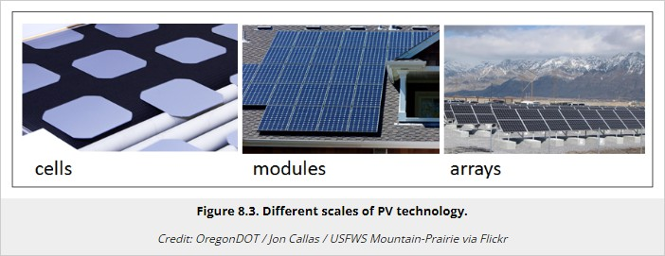
Building Integrated Solar Energy Technologies
AOE 0866 ST
Unit 4

Slide 20
Building Integrated Solar Energy Technologies
•
In this lesson, we choose one of the applications – the building integrated photovoltaics (BIPV) – for more detailed consideration as an interesting example of sustainable technology implementation.
The building-integrated photovoltaics (BIPV) are multifunctional materials that are both structure-supporting and power-generating at the same time. There are some advantages and challenges associated with this technology, which are summarized in table below:
•
AOE 0866 ST
Unit 4

Slide 21
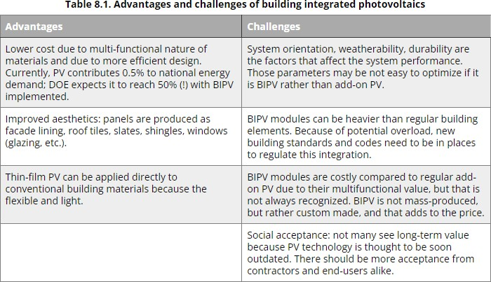
Building Integrated Solar Energy Technologies
AOE 0866 ST
Unit 4

Slide 22
Building Integrated Solar Energy Technologies
•
While the main function of a conventional PV system is ef ficient power generation, the building integrated PV systems, which become the components of the building envelope must satisfy a number of additional requirements, such as:
appearance: color, image, size; weather-tightness;
wind loading;
durability and maintenance;
safety during construction and in use (ﬁre, electrical, structure stability); cost.
•
•
•
•
•
•
AOE 0866 ST
Unit 4

Slide 23
Building Integrated Solar Energy Technologies
•
In order to address all the necessary factors, the PV integration should be discussed early in the beginning of the design process. There are following PV integration options [Robert and Guariento, 2009]:
Shading systems
These include louvers, either horizontal or vertical, which may be mounted outside the building over windows or balconies. Their function is to shade the windows from excessive light. The main issue with these structures is to make them resistant to wind load and easily accessible for maintenance. These subscreens can be made adjustable to maximize the sunlight gain.
Rainscreen systems
Cladding panels can be used to protect the load-bearing external walls from rain water (especially masonry and concrete). PV panels can perform the function of such cladding and tiles. These structures are usually vertical. The ventilated cavity between the exterior cladding and the main wall help keep down the operating temperature of PV cells, enhancing their performance and provide space for cables. PV rain screens have moderate power output due to vertical orientation.
•
•
•
•
AOE 0866 ST
Unit 4

Slide 24
Building Integrated Solar Energy Technologies
•
•
(c) Stick-system curtain walls
Curtain walls are used in those buildings that have internal columns or structural steel to support the main loads. Curtain walls are not weight-bearing and their main function is to resist air and moisture inf iltration; also, building insulation is often attached to them (warm facade). A popular solution is to build the curtain walls from aluminum and steel framing f illed with glass panels. PV panels can be sealed into curtain wall structures in both vision area or opaque area of the facade instead of regular glass.
•
•
Unitized curtain walls
The unitized wall segments are pre-assembled at a factory and then are delivered to the building site. The controlled industrial environment provides more precision and quality for sealing the PV panels into the wall framework and making cable connections.
Double-skin facades
Glass facades are often designed as "double-skin", i.e., when there is signif icant air space between the internal and external glass walls. This helps to reduce heat transfer losses through the walls. PV modules can be readily integrated into the external facade. Ventilation through the double-skin structure provides valuable cooling on the back of the panels.
•
•
AOE 0866 ST
Unit 4

Slide 25
Building Integrated Solar Energy Technologies
•
•
(f) Atria and canopies
For the highest performance, PV are best integrated into horizontal or tilted elements, such as atria and canopies. These structures are usually free from overshadowing and are easy to ventilate. However, these structures may be more prone to heat transfer losses compared to plain opaque or insulated.
AOE 0866 ST
Unit 4

Slide 26
Solar Thermal ElectricPower Generation
•
Solar thermal technologies are designed to convert the incident solar radiation into usable heat. The process of solar heat conversion implies using energy collectors - the specially designed mirrors, lenses, heat exchangers, which would concentrate the radiant energy from the sun and transfer it to a carrier f luid. The f luid passes through the sunlight collector and becomes very hot. Typical heat carrier f lui ds are water/steam, oil, or molten salt. Then the f luid is transferred to the heat engine, which converts the heat to electricity.
AOE 0866 ST
Unit 4

Slide 27
Solar Thermal ElectricPower Generation
•
There are several different kinds of solar collectors, which are described below. These collectors are only functional with the direct beam of sunlight and would also benef it from sun tracking - the technology that keeps the reﬂectors at an optimal angle to the sun.
Flat plate collectors
Flat plate collector is the simplest technology of this kind, which is typically used for reaching temperatures usually no more than 100 degrees above ambient.
•
•
•
AOE 0866 ST
Unit 4

Slide 28
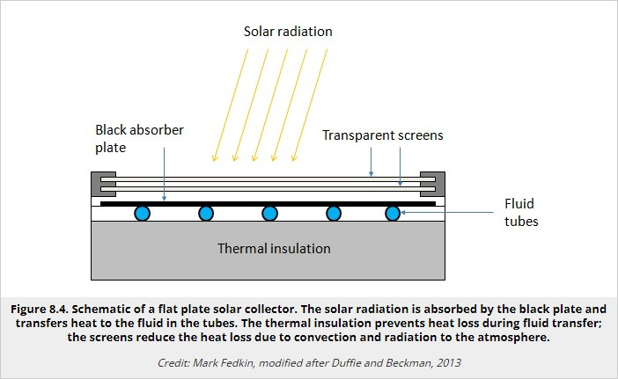
Solar Thermal ElectricPower Generation
AOE 0866 ST
Unit 4

Slide 29
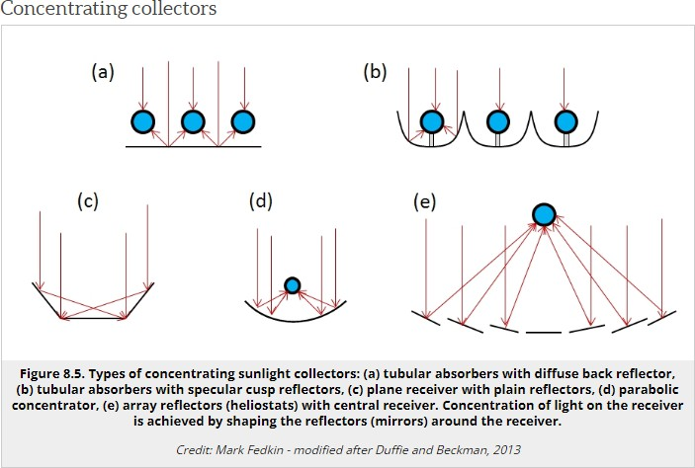
Solar Thermal ElectricPower Generation
AOE 0866 ST
Unit 4

Slide 30
Solar Thermal ElectricPower Generation
•
The above collectors are combined to a bigger energy conversion system. The larger scale solar thermal systems have higher eﬃciency than small systems.
The utility scale solar thermal systems include the following designs:
linear reﬂectors (heating temperatures ~280 ºC); parabolic trough (heating temperatures ~400 ºC);
dish / engine systems (heating temperatures ~650 ºC); solar tower (heating temperatures ~>1000 ºC).
•
•
•
•
•
AOE 0866 ST
Unit 4

Slide 31
Utility Scale Geothermal Energy Systems
•
There is a vast amount of heat contained by the earth interior. This internal heat is mainly comprised of the residual heat of planetary accretion and radioactive heat (from radioactive element decay). The hottest part of the earth is the core, a big part of which is in molten state. Heat radiates and gets transferred from the core to the outer layers of the planet by interior f luids and melts. The general geothermal prof ile of the earth (Figure 8.6) provides an idea of the scale of the thermal resource and the gradual change of the earth temperature at different depths. Because the earth structure is not uniform, heat is more readily transferred in some zones than in others. High heat transfer is usually associated with fracture zones and major faults, which are often located at the boundaries of tectonic plates.
AOE 0866 ST
Unit 4

Slide 32
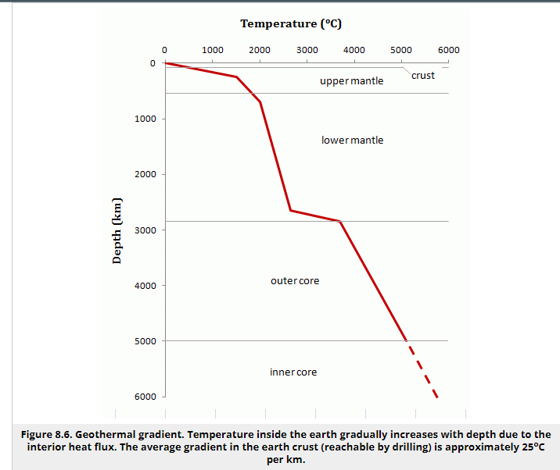
Utility Scale Geothermal Energy Systems
AOE 0866 ST
Unit 4

Slide 33
Utility Scale Geothermal Energy Systems
•
The temperature change rate with depth depends on the density and thermal conductivity of rocks. Subdivision of the earth structure into layers is made according to the rock composition and rheological properties, so we see that the thermal prof ile within each layer can be quite different. The drastic change in temperature pattern around the boundary between the lower mantle and outer core is apparently related to the transition of the molten state.
The heat ﬂux within the crust (the thin top layer) is highly variable due to the existence of large unif ied fragments of the crust (plates) divided by plate boundaries, the more mobile zones, where plates collide, spread out, or move relative to one another. Increased mobility of the plate boundary zones may cause creation of faults of various depth, which favor heat transfer to the surface. If you want more background about plate tectonic theory, you will be able to f ind a lot of resource on the web. For example, An Introduction to Plate Tectonics provides a nice and concise illustrated introduction to this whole idea.
•
AOE 0866 ST
Unit 4

Slide 34



Wind Energy Application And Technologies
•
•
Air is the basic necessity of life. Man cannot live without air for more than three minutes Air is a mechanical mixture of various gases like oxygen, Nitrogen, Carbon dioxide, water vapour, ozone and other gases. Oxygen is needed by the body for many of vital functions Oxygen, Nitrogen Carbon dioxide water vapour, ozone and other gases. Oxygen is needed by the body for many of its vital functions.
Air is an important natural resource. In order to utilize air as a good resource we have to control the Air Pollution, which is due to industry, thermal power stations, automobiles, and domestic combustion etc. There are always additions of a number of harmful gases to atmosphere. These adversely affect air quality and make it unﬁt for living organisms.
Moving air is known as wind which produces energy. Like solar energy, wind energy is a very important non-conventional source of energy. In India, the wind power is of great signif icance as there are large coastal, hill, and desert where wind energy can be carefully exploited for generation of electricity and water pumping. Wind energy may be converted into mechanical and electrical energies. Wind energy in India is generally utilized in wind pumps, wind battery charges, wind electricity generators etc.
•
•
AOE 0866 ST
Unit 4

Slide 35




Wind Energy Application And Technologies
•
•
•
•
•
•
•
The wind energy is used to propel the sailboats in river and seas to transport men and materials from one place to another.
Wind energy is used to run pumps to draw water from the grounds through wind mills.
Wind energy has also been used to run ﬂourmills to grind the grains like wheat and corn into ﬂour.
Now-a-days wind energy is being used to generate electricity.
Wind energy may be considered as the world’s fastest growing energy source.
By the development of technology, wind power may become most economical and environmental friendly source of electricity in many countries in the coming 10 to 20 years.
AOE 0866 ST
Unit 4

Slide 36
Bio-mass Fuelled Combined Heat And Power Systems
•
Biomass as a source of fuel has been part of the global energy economy throughout human history. Using biomass as fuel (via combustion) may help solve the fuel supply issue, since biomass is renewable, but does not help solve the global carbon emission and pollution problem: burning biomass produces CO, CO₂, NO_{x}, and other gases at the levels exceeding those from traditional fossil fuels (e.g., oil, gas).
Indirect utilization of biomass implies the production of various biofuels (for example, ethanol), which can be converted to energy in a cleaner way. Types of biomass currently on market and ways to produce them are well described in the Biomass Wikipedia(link is external) article
•
AOE 0866 ST
Unit 4

Slide 37
Bio-mass Fuelled Combined Heat And Power Systems
•
•
Biomass combined heat and power (CHP)
Biomass-fueled CHP or cogeneration is one of the applied technologies developed as a cost-effective method of energy recovery. Because the by- product heat generated in electricity generation is not wasted, but rather utilized as thermal energy, the total eﬃciency of such systems reaches 60-80%.
There are three main stages in the biomass-fueled CHP process: biomass collection and preparation
biomass conversion: (i) to steam or (ii) to biogas power and heat generation
These three stages are integrated in one installation.
The following bio resources are considered for energy recovery: energy crops and crop residues
forest residues and wood waste
manure biogas and wastewater treatment biogas food processing residue
municipal solid waste (MSW) landﬁll gas
•
•
•
•
•
•
•
•
•
•
•
•
AOE 0866 ST
Unit 4

Slide 38
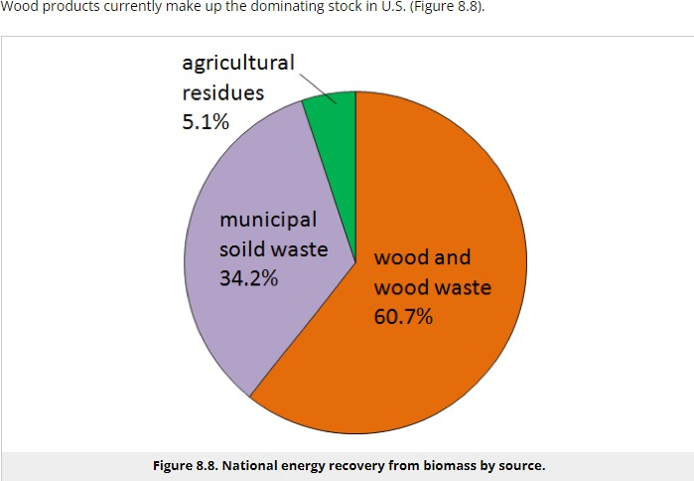
Bio-mass Fuelled Combined Heat And Power Systems
AOE 0866 ST
Unit 4

Slide 39
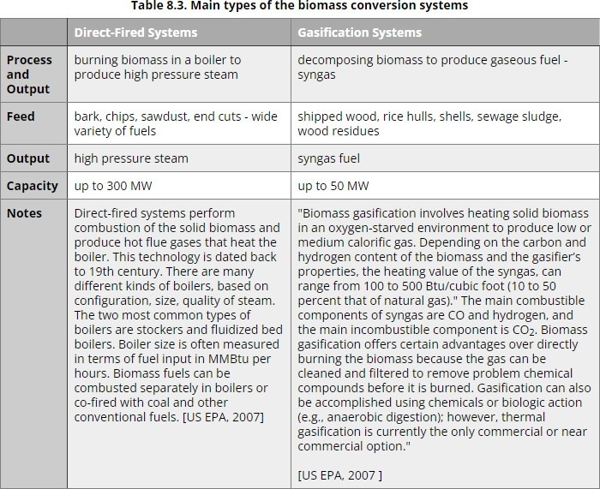
Bio-mass Fuelled Combined Heat And Power Systems
AOE 0866 ST
Unit 4

Slide 40
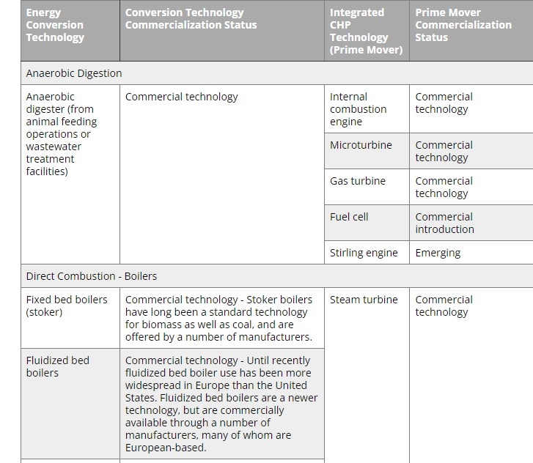
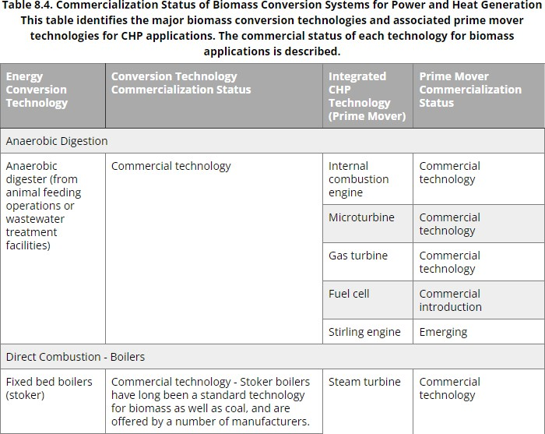
AOE 0866 ST
Unit 4

Slide 41
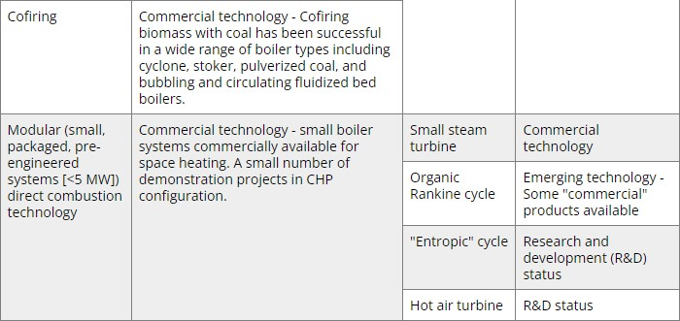
Bio-mass Fuelled Combined Heat And Power Systems
AOE 0866 ST
Unit 4

Slide 42
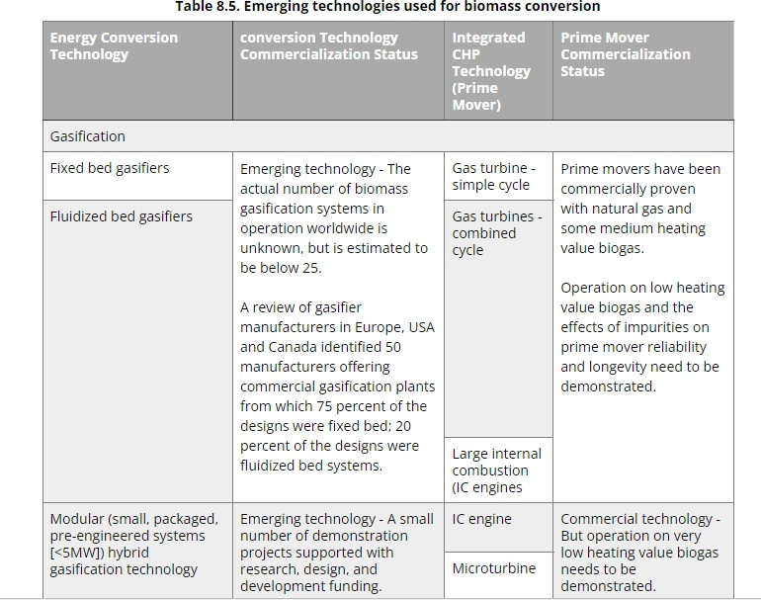
Bio-mass Fuelled Combined Heat And Power Systems
AOE 0866 ST
Unit 4

Slide 43

Bio-mass Fuelled Combined Heat And Power Systems
AOE 0866 ST
Unit 4

Slide 44
Bio-mass Fuelled Combined Heat And Power Systems
•
•
Social considerations
While the biomass energy offers benef its in terms of sustainable fuel supply, it can potentially aggravate the air pollution problem. Except for a very narrow range of applications of biofuels in no-combustion devices, such as fuel cells (which can generate electricity electrochemically with bio-hydrogen and syngas), most of the biomass energy technologies involve burning the fuel and result in greenhouse gas emissions. This drives public opinion away from biomass options towards such alternatives as solar and wind energy. The second issue debated is the potential competition for land use between the energy and food crops.
•
AOE 0866 ST
Unit 4

Slide 45
Environmental Impact Of Renewable Energy
•
Over the next 20 years, policymakers, industry and government of ficials will need to invest US $2. 5 trillion for electricity generation. Electricity from renewable energy sources produces between 90-99% less greenhouse gases (GHGs) compared with coal-ﬁred plants and causes 70-90% less pollution.
Focusing on renewable energy sources other than fossil fuels and coals might help in avoiding environmental impacts, specif ically from air pollution and GHGs. Nevertheless, all forms of electricity generation have their impacts. To achieve a low- carbon future, we need to understand the effects of different renewable energy resources.
•
AOE 0866 ST
Unit 4

Slide 46
Environmental Impact Of Renewable Energy
•
•
Where does renewable energy come from?
Renewable energy is derived from natural sources that are continuously and sustainably replenished. Renewable energy comes from wind energy, solar energy, biomass energy, biogas energy, geothermal energy, hydro power and offshore wind, wave, and tidal energy. A wind turbine may have a lifespan of 20-25 years, according to Thomas Gibon, meaning the material investments may last for 20-25 years before needing to be replaced.
AOE 0866 ST
Unit 4

Slide 47
Environmental Impact Of Renewable Energy
•
•
What environmental impacts do renewable energy installations have?
The materials used in creating renewable energy installations include neodymium, dysprosium, cadmium, tellurium, gallium, indium and selenium. These materials have been used only recently, which means that there are limited or no recycling systems yet. A solution to facilitate the large-scale recycling of these materials needs to be designed to avoid problems in the future. There are not currently enough renewable power plants to be retired that could be studied to address this issue empirically.
Hydropower’s environmental impacts depend on where the installation is located. For instance, a tropical hydropower installation that is big and shallow can result in GHG emissions when it swamps and kills vegetation. Carbon dioxide (CO2) is released in such instances, as well as methane (CH4), a GHG that is about 30 times more powerful than CO2 at trapping heat within the atmosphere.
•
AOE 0866 ST
Unit 4

Slide 48
Environmental Impact Of Renewable Energy
•
Solar panels, designed to absorb the sun’s rays as a source of energy to be used for electricity or heating, must be evaluated as well. Solar energy does not operate at night without a storage device such as a battery, and cloudy weather can lead to unreliability during the day. Solar energy remains useful, but further research must be done in order to have a fuller understanding of how to maximize its beneﬁts.
•
•
In sum, renewable energy installations are critical to keeping global warming under 2°C, and their environmental impacts should be studied as rigorously as we evaluate non-renewables to realize their maximum potential.
AOE 0866 ST
Unit 4

Slide 49
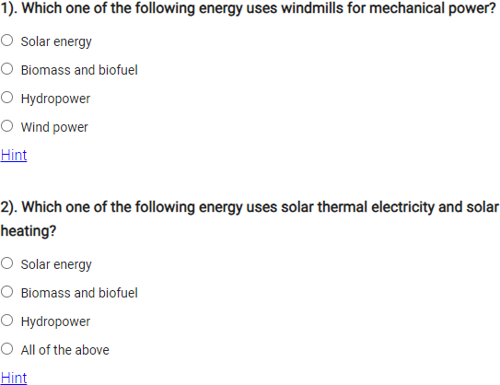
MCQS
AOE 0866 ST
Unit 4

Slide 50
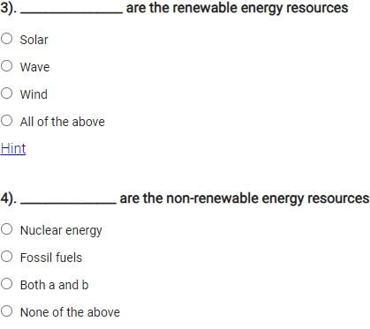
MCQS
AOE 0866 ST
Unit 4

Slide 51
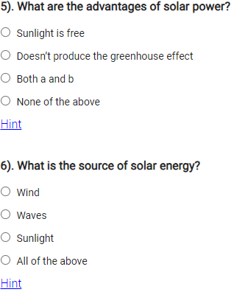
MCQS
AOE 0866 ST
Unit 4

Slide 52
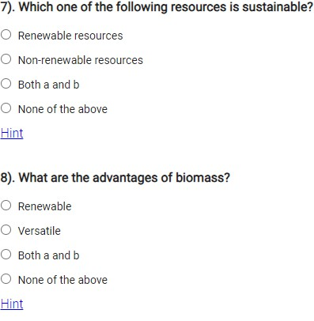
MCQS
AOE 0866 ST
Unit 4

Slide 53
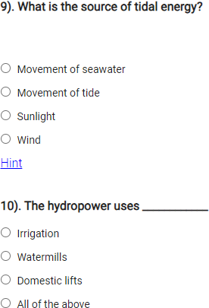
MCQS
AOE 0866 ST
Unit 4

Slide 54









AOE 0866 ST
Unit 4
59

